Slide 1
Path Tracing & Irradiance Caching on the Cornell Box
Vicky Li & Yifan Wang

Slide 2
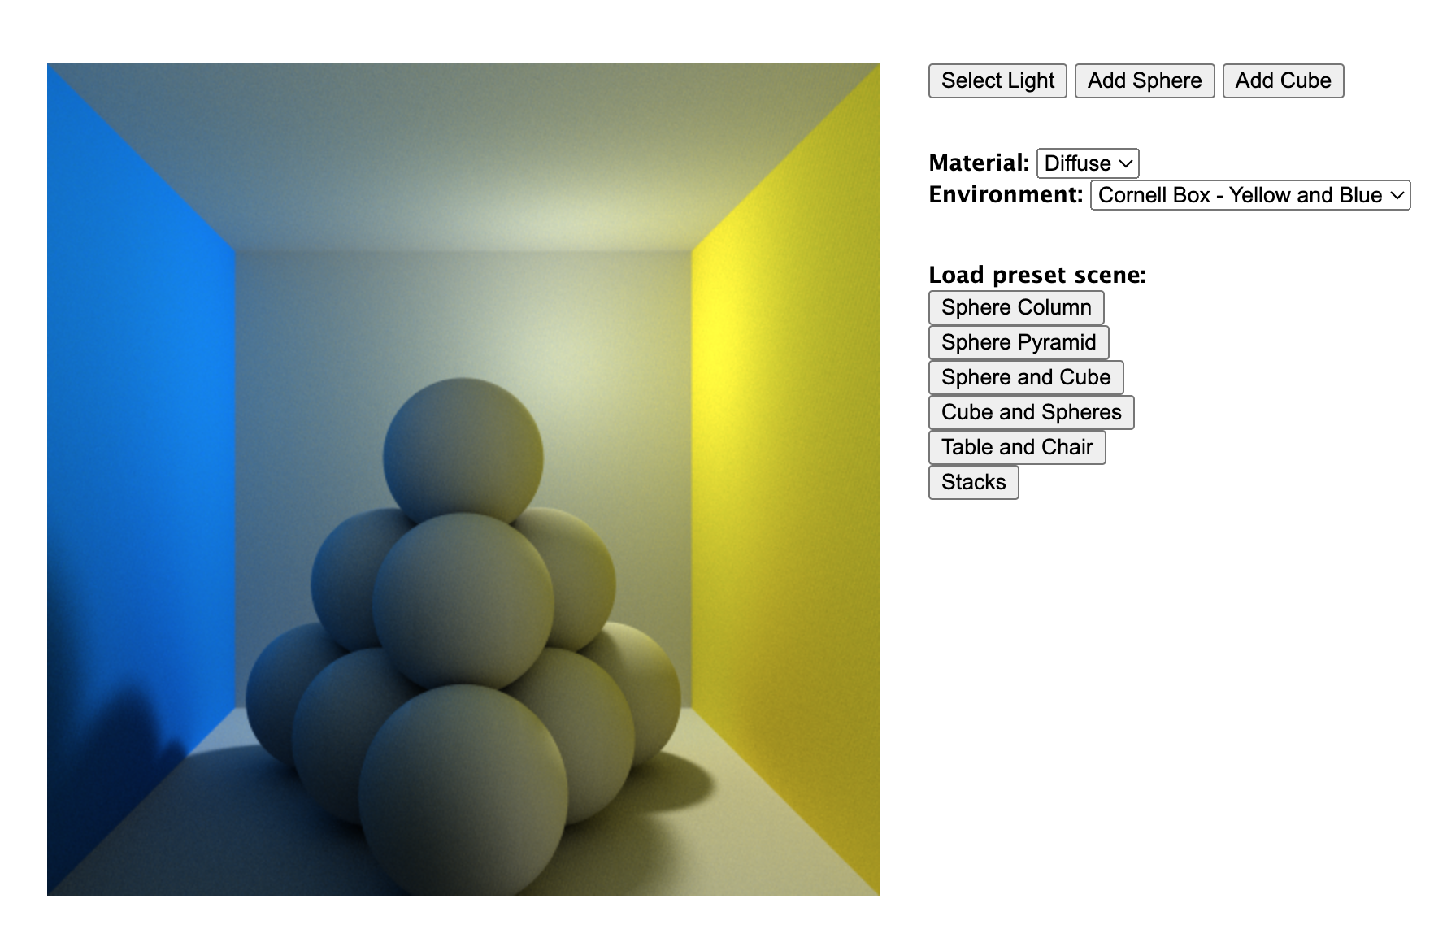
Motivation
Wanted to recreate the WebGL Path Tracing demo by Evan Wallace
Difficulty converting from OpenGL to WebGL
Pivoted our project to rendering scenes from above demo using path tracing vs. irradiance caching
Notes:
The initial idea for our project was to recreate a slightly simpler version the WebGL Path Tracing demo by Evan Wallace where we have a Cornell Box with several preset scenes and functionalities. However, upon encountering many difficulties, we decided to pivot our project to rendering scenes from the said demo with two rendering algorithms, path tracing and irradiance caching.

Slide 3
Background
Path Tracing: Simulate physical behavior of light rays by tracing the most probable path of light
Irradiance Caching: Optimizes rendering process by precomputing and storing irradiance values at specific points in the scene, allowing for reuses of this information
Kept the same preset scene and functionality ideas from WebGL Path Tracing demo
Notes:
Path tracing and irradiance caching both very popular and commonly used rendering algorithms. But path tracing mainly involves simulating physical behavior of light rays by tracing the most probable path of light white irradiance caching optimizes rendering process by precomputing and storing irradiance values.

Slide 4
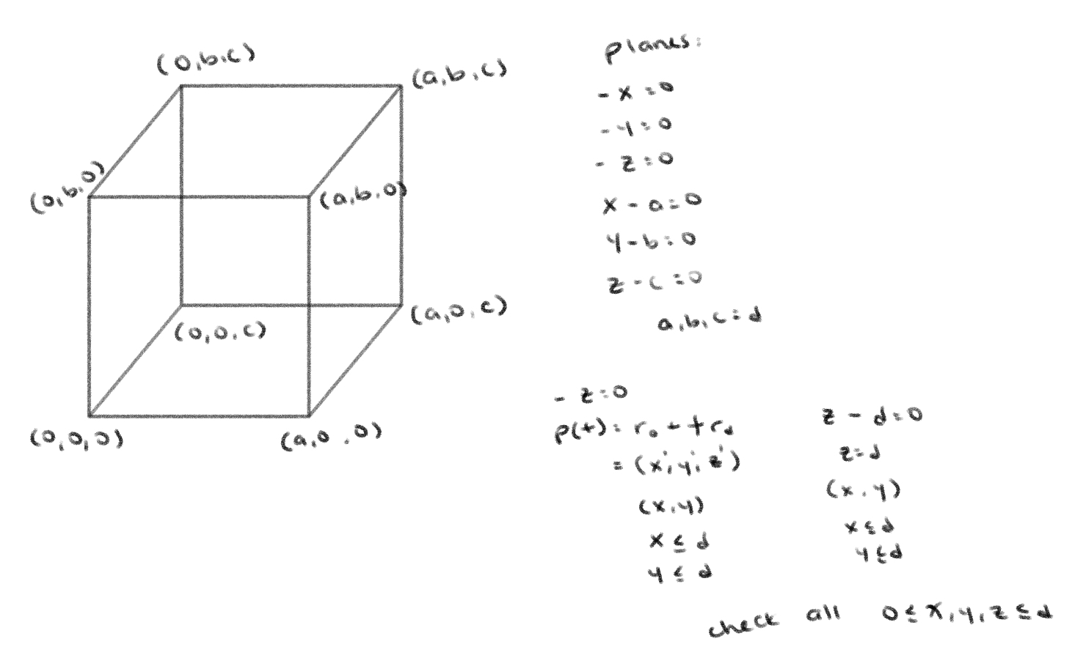
Scene Creation
Adopted hittables from assignment 4
Cubes & Cornell box:
5-6 planes, render color only if ray from camera intersects plane at a specific region
Notes:
To make our scene, we adopted the hittables code from assignment 4 and made our own cubes and cornell box. To do so, we created 5-6 planes and only render its color if the ray from the camera intersects the plane at a specific region.

Slide 5
Path Tracing
Color for each pixel = average of all samples
N = 100 samples
Per sample: color = direct illumination + indirect illumination * specular color of material
Direct Illumination = ambient + diffuse + specular
Generated ray by sampling a random direction in the hemisphere defined by the hit normal
Indirect Illumination = BRDF * incoming light * cosine of angle between generated ray and hit normal / p
BRDF = specular value of material / π
incoming light = result of recursive call
p = 1/(2π)
Notes:
With path tracing, the color for each pixel is the average of all samples for that pixel. To generate our images, we set N equal to 100 samples. For each sample, the color is calculated by summing the direct illumination and the indirect illumination multiplied by the specular color of the material. Similar to assignment 4, the direct illumination is just the sum of the ambient, diffuse, and specular shadings of the material of the object the ray hit. To get the indirect illumination, we generated a ray from the hit point by sampling a random direction in the hemisphere defined by the hit normal. The indirect illumination calculation is the BRDF of the generated ray * the result of the recursive call of path tracing of the new ray * the cosine of the angle between the generated ray and the hit normal / the probability of the new ray, which is 1/(2*pi).

Slide 6
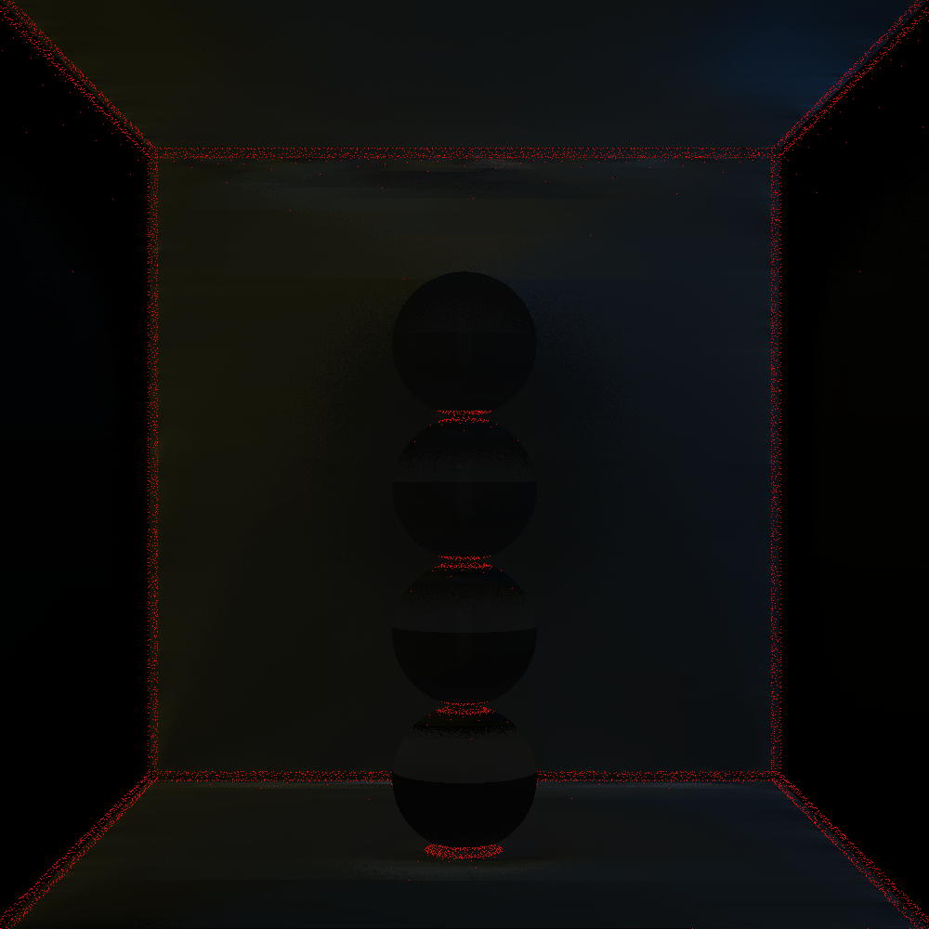
Irradiance Caching
Store an array of cached entries
For each pixel (sample point), interpolate from valid entries if exist
If no entries exist:
Irradiance = color from path tracing
Notes:
The basic idea of irradiance caching is simple: store an array of cached entries. Each entry contains the position, normal, harmonic mean, and irradiance for the cached sample point. Then for each pixel or sample point, interpolate from valid entries if they exist. If there are no valid entries, let the irradiance at the sample point to be the color calculated from path tracing and store it as a new entry

Slide 7
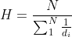
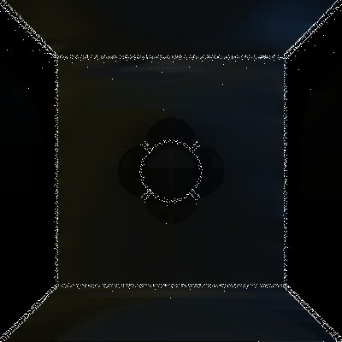
Irradiance Caching: Determining valid entries
Entry in range: harmonic mean
N = 100 random samples, each with hit distance d_{i}
Denser in corners, sparse in open space
Normals should not be too different
dot(n, n_{i}) ≥ 0.314
Notes:
To determine if there exists valid entries in the array, we must perform two checks, the first checking that the entry is in range. We do so using the harmonic mean, using N=100 random rays from the sample point, each with hit distance di. Using the harmonic mean distance means that cached points that “see” nearby geometry will have a smaller valid radii while points far away from visible geometry will have a larger radii. This also means that the cache entry distribution will be denser in corners and crevices and sparse in open space. This matches up well with where the indirect irradiance is likely to change the fastest.
The second check is to make sure that the normals are not to different from each other. In our implementation, we check that the dot product between the sample normal and the entry normal is greater than or equal to some arbitrary number 0.314

Slide 8
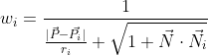
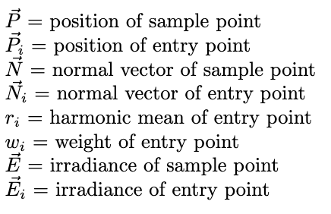
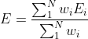
Irradiance Caching: Interpolating
Weights according to Ward’s ‘88 SIGGRAPH paper
Weighted sum of all valid entries
Notes:
For each valid entry, we calculate their weight using a formula proposed by Ward. We then use the weighted sum of the irradiance of the valid entry points as the irradiance at the sample point.

Slide 9
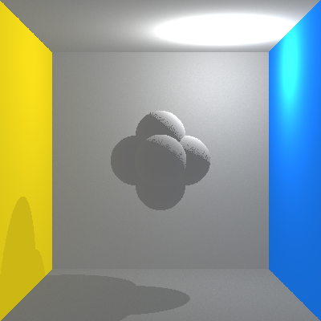
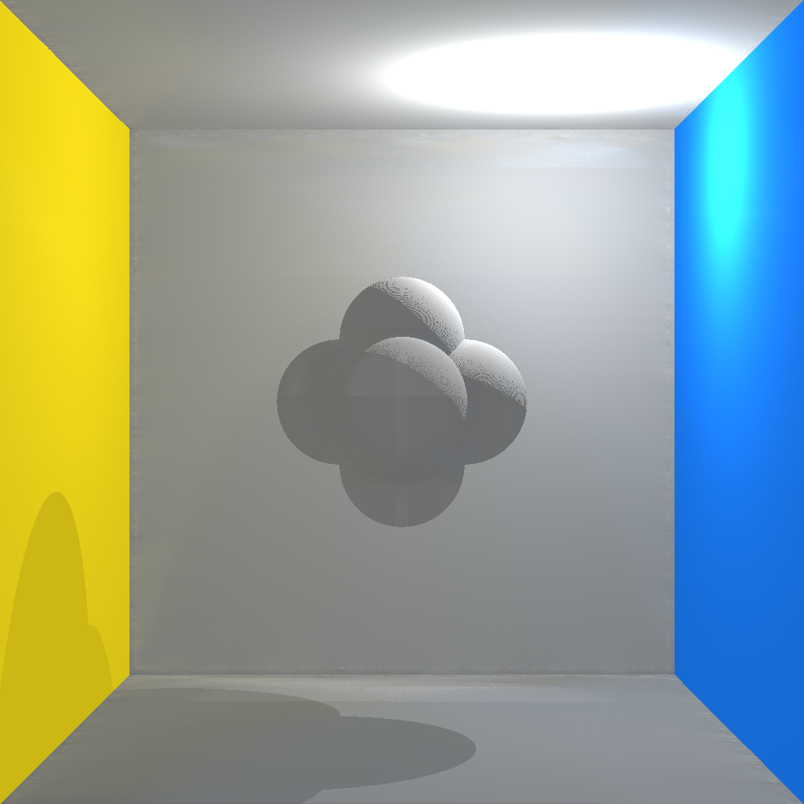
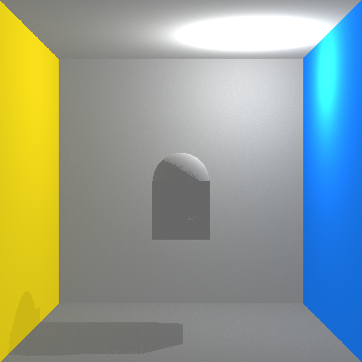
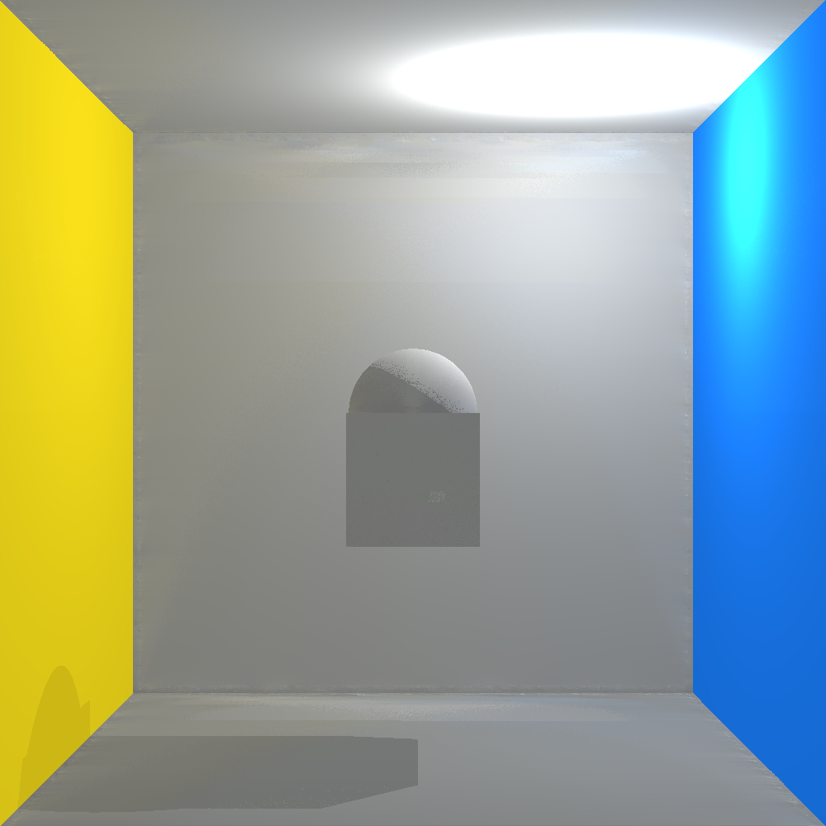
Results 800 x 800
Path Tracing: 79.38s Irradiance Caching: 26.39s
Notes:
Here is an example of one scene we’ve rendered, an 800x800 Cornell box with one sphere and cube. We see the light on the upper right side of the box, and thus casting a shadow on the lower left. Although hard to see, the wall in the back slightly changes color from yellow to blue, left to right, as it slightly reflects the color from the other two walls.

Slide 10
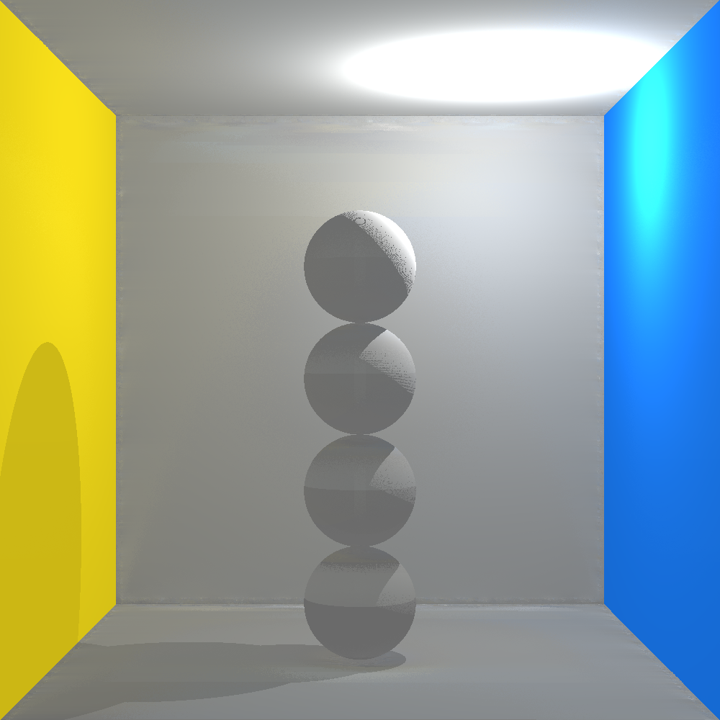
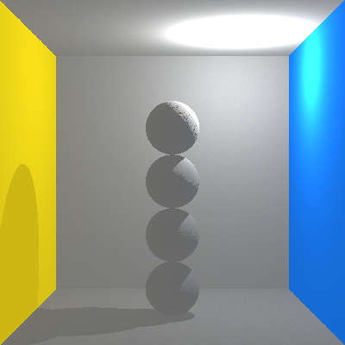
Results 800 x 800
Path Tracing: 147.34s Irradiance Caching: 38.27s
Notes:
We see similar results in our sphere column scene.

Slide 11
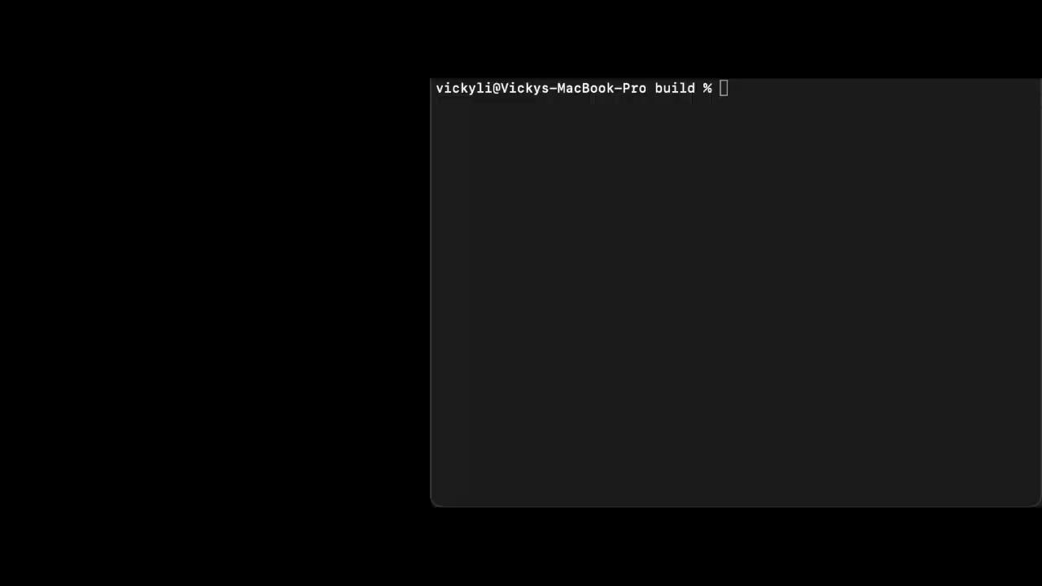
Demo: Adding, Removing, Changing Material
Notes:
Here, we will demonstrate some of the toggling functionalities from the original WebGL demo that we implemented, specifically we will show add_sphere, delete_sphere, and changing surface material. In the command line, we have specific arguments for specific functionalities, such as choosing which algorithm to use, the size of the image, and whether to add or delete an object or to change the material to mirror (as the default is set to diffuse).
First, we render a 400x400 sphere column scene with the default number of spheres and material using irradiance caching. Next, we add a sphere to the scene, and we can see that in the upper right corner. We then render the same scene with a sphere removed. We can also run both add and delete sphere in the same image as shown here. Lastly, we change the rendering algorithm to path tracing and the material of the sphere to mirror. Here is the image with the default material and with material_mirror set to true the spheres become mirrors.

